Slide 1
Robust Robotic Grasping Utilising Touch Sensing
Justin Koo
March 22, 2023

Slide 2
Progress - MLP approach (50% complete)
Aim of approach: To generalise grasping rules for 3 primitive objects – e.g. A MLP trained on rectangular blocks of varying dimensions should ideally be able to grasp an unseen block of different dimensions.

Slide 3
MLP
Data collection:
Collected 600 samples of tactile and visual data for 3 blocks and 3 cylinders of different dimension
Dataset is balanced (300 successful grasps, 300 unsuccessful grasps)
TODO: Collect remaining data on a third primitive object, e.g. sphere
2. Feature selection
3. Training

Slide 4
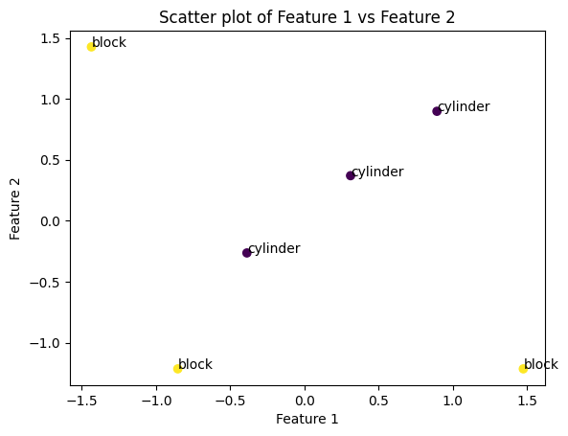
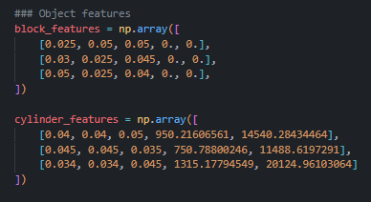
MLP
Data collection & feature selection
Feature selection
Object features: Width, height, depth and curvature (using principle-curvature based region detector (2 components)) -> 5D
To check if the features can represent object class, performed normalisation and then spectral clustering / K-Means
Result: clustering correctly differentiates between blocks and cylinders, but plot doesn’t show clustered groups

Slide 5
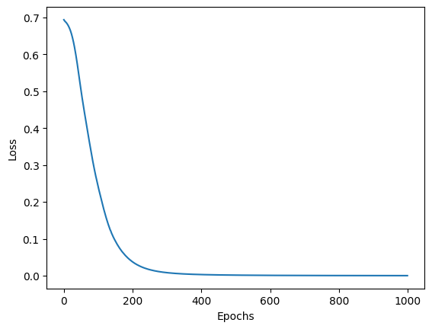
MLP
Data collection & feature selection
Data pre-processing
3. Training:
So far, only trained MLP for blocks on tactile +
visual data, with CNN to reduce dimensionality
85% validation grasping accuracy
TODO: Use PCA on the CNN-transformed data
and retrain MLP to see difference
TODO: Combine datasets of the 3 primitive
object types and train MLP

Slide 6
MLP - experiments
Test if MLP can generalise a grasp for a primitive object
Train MLP on data from 2 blocks; test on data from another block. Each block has different dimensions

Slide 7
What next?
Complete MLP approach (collect enough data)
Reduce dimensionality of tactile data down to 6D (from 128D) using PCA (ensure components capture >90% of data variance)
Evaluation on MLP (with real data)

